Slide 1
ENG 346 Data Structures and Algorithms for Artificial Intelligence Linked Lists
Dr. Mehmet PEKMEZCİ
mpekmezci@gtu.edu.tr
https://github.com/mehmetpekmezci/GTU-ENG-346

Slide 2
Agenda
Singly Linked Lists
Stacks Revisited
Queues Revisited
Doubly Linked Lists

Slide 3
Linked List
Organize and store a collection of elements, called nodes, in a linear sequence
Each node in a linked list has
Data: Actual value or information to store in the list.
Reference(s): Represents the connection(s) between nodes in the sequence.
Type of linked lists:
Singly linked list
Doubly linked list
Circular linked list

Slide 4
Advantages of Linked Lists
Dynamic Size: Can easily grow or shrink in size by adding or removing nodes.
Efficient Insertions and Deletions: Insertions and deletions at the beginning or middle of a linked list can be done in constant time.
Memory Efficiency: Linked lists use memory more efficiently since they allocate memory for each node as needed.
No Need for Pre-allocation: Linked lists don't require you to specify the size of the list in advance.
Constant-Time Insertions at the Head.
Easy Implementation of Other Data Structures like stacks, queues, and hash tables.
Notes:
Dynamic Size: Linked lists can easily grow or shrink in size by adding or removing nodes. In contrast, regular lists (arrays) are often allocated a fixed amount of memory, and resizing them can be inefficient and error-prone.
Efficient Insertions and Deletions: Insertions and deletions at the beginning or middle of a linked list can be done in constant time (O(1)) if you have a reference to the node where the operation is to be performed. In contrast, adding or removing elements in the middle of a regular list requires shifting elements, which can be O(n) in the worst case.
Memory Efficiency: Linked lists use memory more efficiently since they allocate memory for each node as needed. In regular lists, memory is often allocated in fixed-size chunks, which can lead to wasted memory when the list size is smaller than the allocated chunk size.
No Need for Pre-allocation: Linked lists don't require you to specify the size of the list in advance. You can keep adding elements as needed without worrying about resizing or reallocation.
Constant-Time Insertions at the Head: Inserting an element at the beginning of a linked list is a constant-time operation (O(1)), as it only involves creating a new node and updating references. In a regular list, inserting at the beginning requires shifting all existing elements, which is O(n).
Easy Implementation of Other Data Structures: Linked lists serve as the foundation for other data structures like stacks, queues, and hash tables. They are often used as building blocks for more complex data structures.

Slide 5
Disadvantages of Linked Lists
Inefficient Random Access: Accessing an element at a specific index in a linked list can be inefficient, taking O(n) time in the worst case.
Increased Memory Overhead: Each node in a linked list requires additional memory to store the reference to the next node.
Slower Traversal: Traversing a linked list can be slower than iterating through an array because it involves following references from one node to the next.

Slide 6
Singly Linked Lists
A singly linked list is a concrete data structure consisting of a sequence of nodes, starting from a head pointer.
Each node stores
Data
Link to the next node
Node
tail
head
next
∅
Data
A
B
C
D

Slide 7
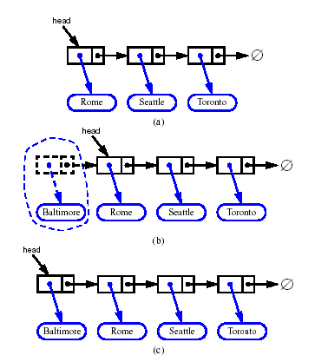
Inserting at the Head
Allocate a new node
Insert new element
Have new node point to old head
Update head to point to new node

Slide 8
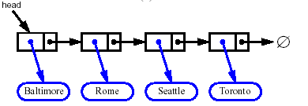


Removing from the Head
Update head to point to next node in the list
Allow garbage collector to reclaim the former first node

Slide 9
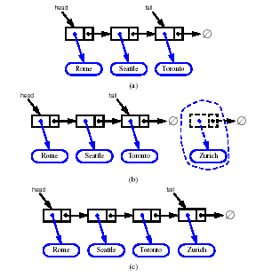
Inserting at the Tail
Allocate a new node
Insert new element
Have new node point to null
Have old last node point to new node
Update tail to point to new node

Slide 10
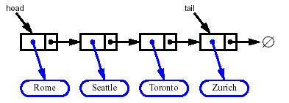
Removing from the Tail
Removing at the tail of a singly linked list is not efficient!
There is no constant-time way to update the tail to point to the previous node

Slide 11
Stack as a Linked List
Implement a stack with a singly linked list
The top element ➔ The first node of the list
The space used is O(n) and each operation of the Stack ADT takes O(1) time

Slide 12
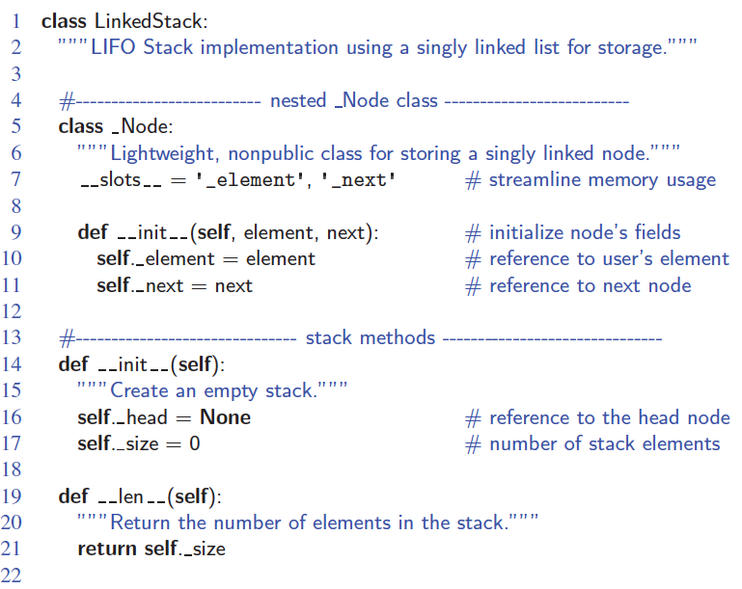
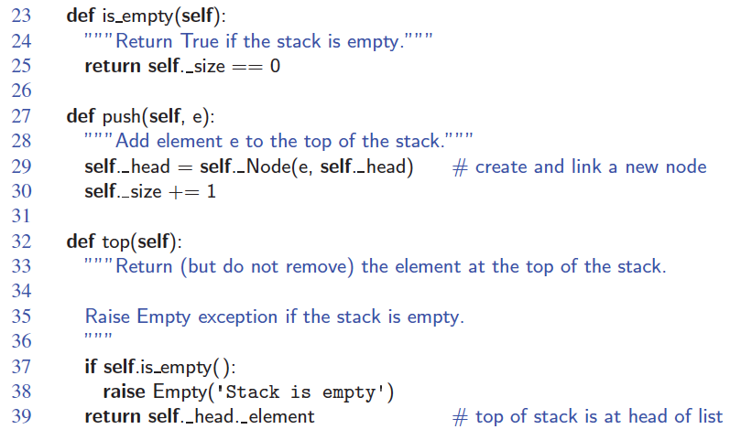
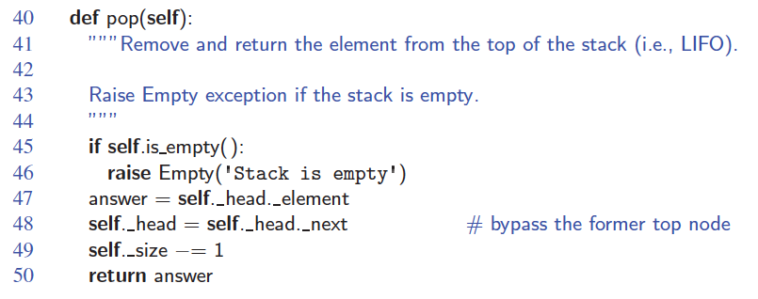
Linked-List Stack in Python

Slide 13
Queue as a Linked List
Implement a queue with a singly linked list
The front element ➔ the first node
The rear element ➔ the last node
The space used is O(n) and each operation of the Queue ADT takes O(1) time

Slide 14
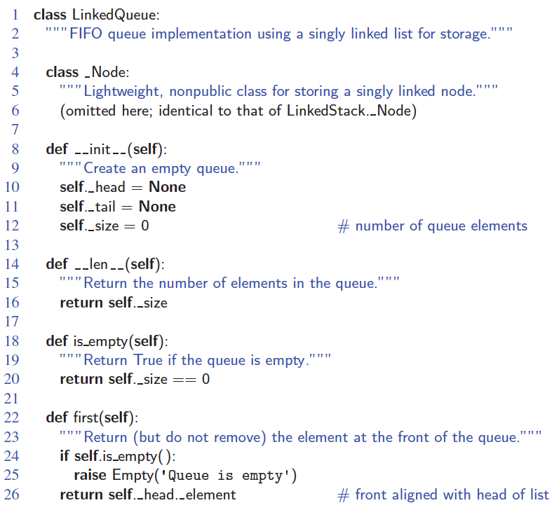
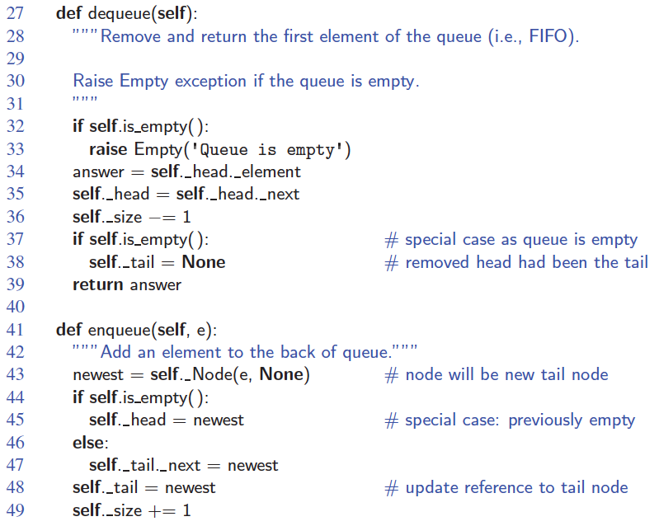
Linked-List Queue in Python

Slide 15
Doubly Linked List
A linked list which can be traversed in both directions.
Each Node stores:
Data
Link to the previous node
Link to the next node
Node
header
Nodes
trailer
prev
next
Data

Slide 16
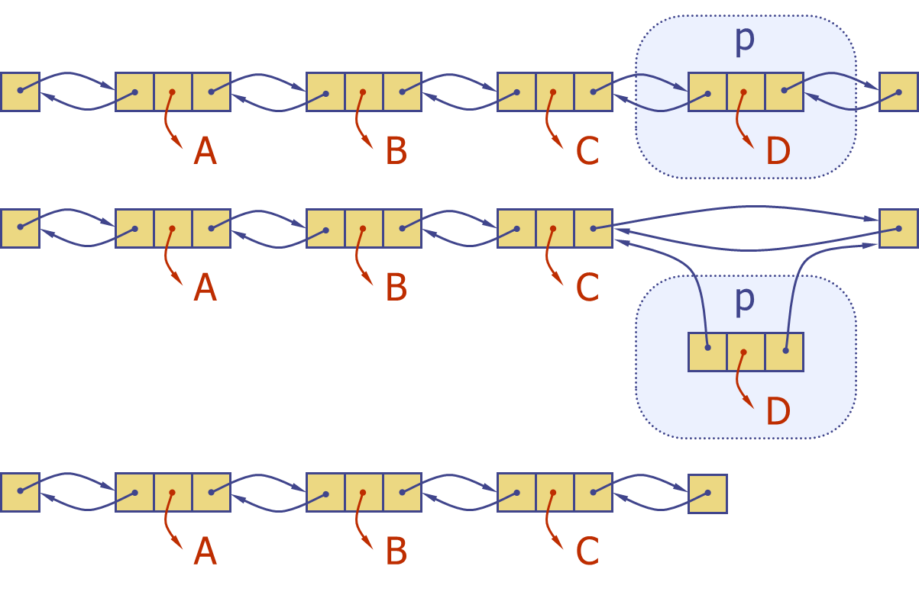
Deletion from Doubly Linked List
Remove a node, p, from a doubly-linked list.

Slide 17
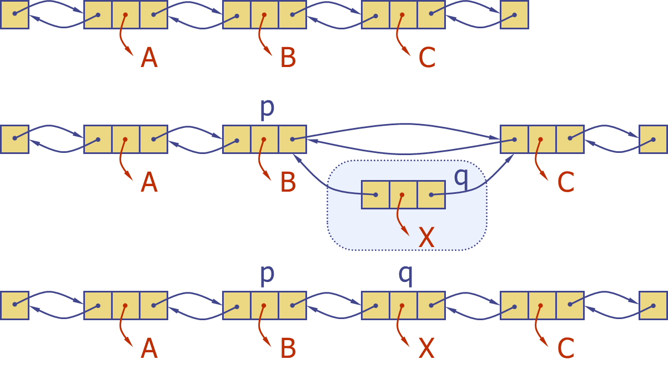
Insertion to Doubly Linked List
Insert a new node, q, between p and its successor.

Slide 18
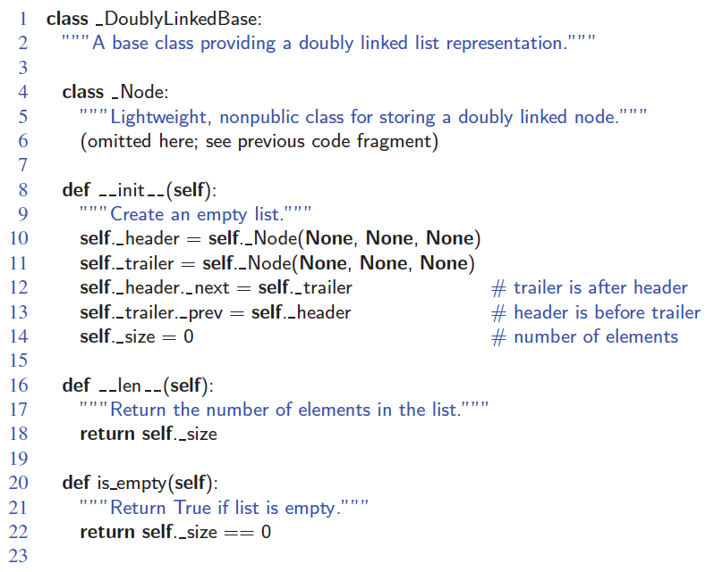
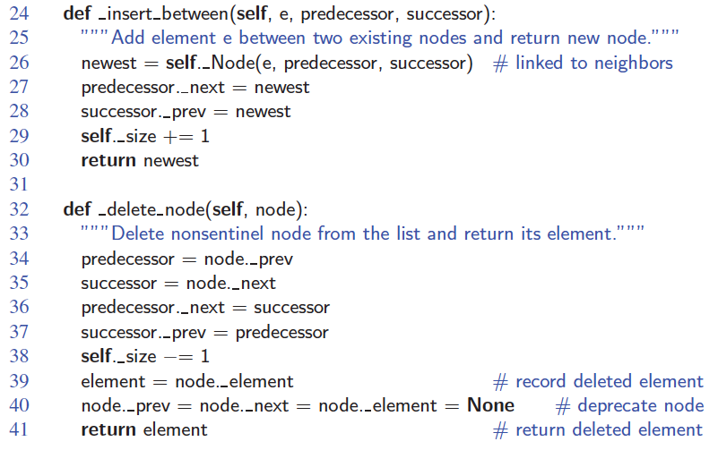
Doubly Linked List in Python

Slide 19
Circular Linked List

